Slide 1

Fake News Filter
By: Om Shreenidhi, Atharva Joshi, Saksham Gupta, Anurag Parvatikar & Sathwik Kallapur

Slide 2
Description
Our model focusses on detecting fake messages sent from one user to another via a messaging platform.
It takes the content and performs a news search based on the message and records the results from the most reliable sources of media.
The relevant information is then extracted from these sources and stored.
From here we use various NLP pre-processing methods such as lemmatization, stop word removal, tokenization etc.
The data extracted is compared with the original message and a similarity score is assigned.
We are doing this by using a primitive cosine similarity model.
A more reliable alternative would be an RNN model (more specifically, LSTM) which is trained to compare two strings for the similarity in the information contained (an important point to note here is that the INFORMATION is being compared and not the strings themselves).
If, for a given message, the similarity score at any point of time exceeds a certain threshold value (say, 0.75), it can be considered a genuine, legitimate message.
Otherwise, it will be flagged as a message whose information is "not verified" and the user can choose to filter them out if he/she wants to.
Another point of importance: The user must be given the option to view these filtered messages because they could be informal messages sent by friends/relatives without any ill intentions.

Slide 3
Approach
Perform a Google search on the content in a given message
Extract the content of reliable sources of news that appear in the results [SCRAPING]
Evaluate the similarity between entire articles scraped in the above step and the content in the message under consideration, assign a similarity score to it and repeat this step between individual lines in each article and the message
If the similarity metric exceeds a given threshold value(say, 0.75) at any point of time, stop the process and flag the message as a legitimate message
If the similarity metric never reaches the threshold, flag the message as an unverified message

Slide 4
Scraping
We use the following modules:
googlesearch
newspaper
And the following functions for web scraping and article gathering:
googlesearch.search()
newspaper.Article()
newspaper.download()
newspaper.parse()
newspaper.nlp()
Note: The newspaper.Article() function mentioned above is used to instantiate an Article object. It accepts url and language as parameters, and has an attribute ‘object.text’ which
Is a string holding the content of the article.

Slide 5
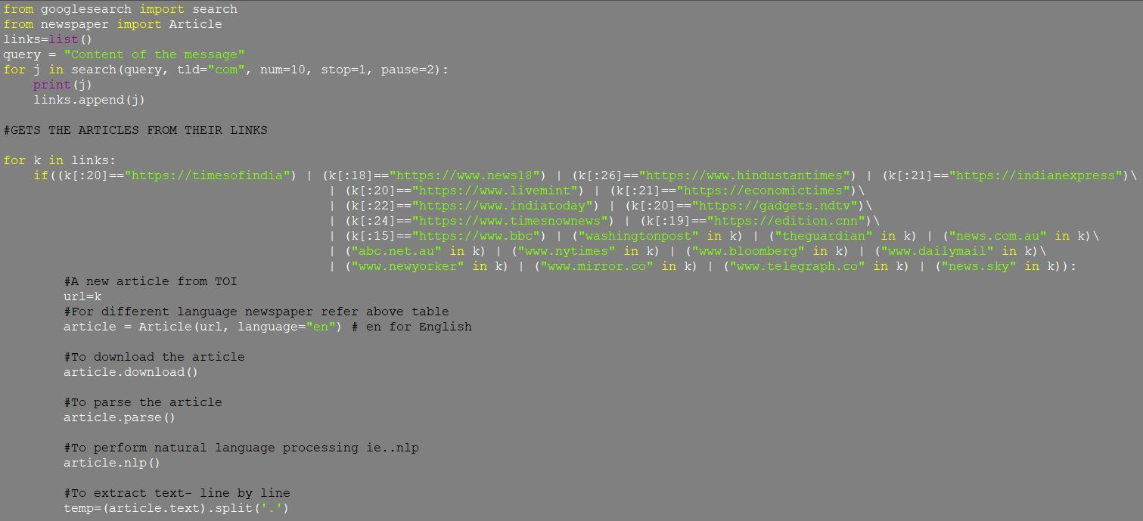
Scraping - Code

Slide 6
Preprocessing
Stop word-removal
Lemmatization
Finding Term Frequency-Inverse Document Frequency
Considering only those words with high TFIDF values for scraping

Slide 7
Preprocessing
We use the following modules:
re
nltk
collections
And the following functions for NLP preprocessing:
nltk.corpus.stopwords()
nltk.stem.porter.PorterStemmer()
nltk.stem.WordNetLemmatizer()
re.sub()
collections.Counter()
And additionally, we define 3 functions:
computeTF(): computes term frequency
computeIDF(): computes inverse document frequency
computeTFIDF(): computes term frequency-inverse document frequency

Slide 8
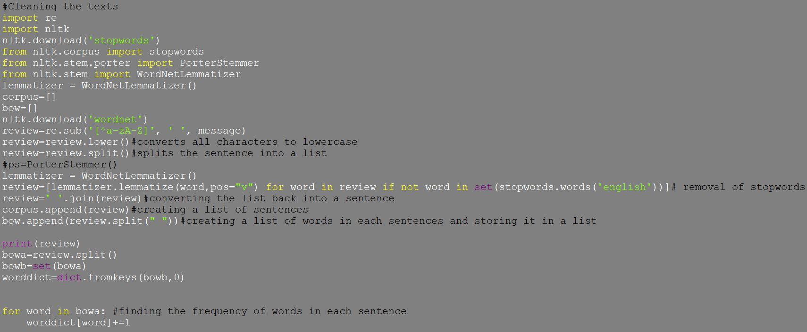
Preprocessing - Code

Slide 9
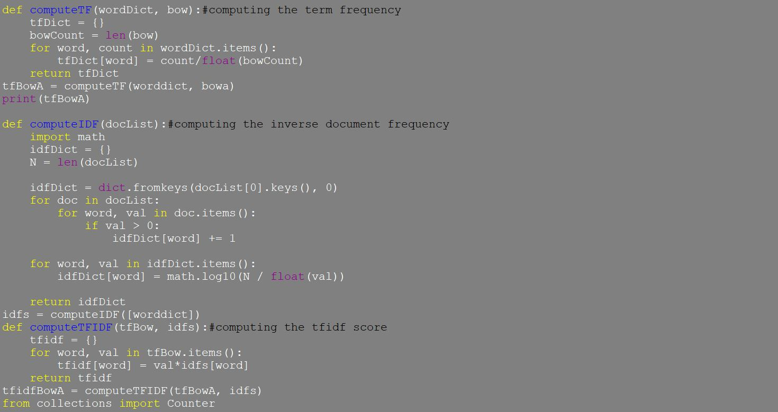
Preprocessing - Code

Slide 10
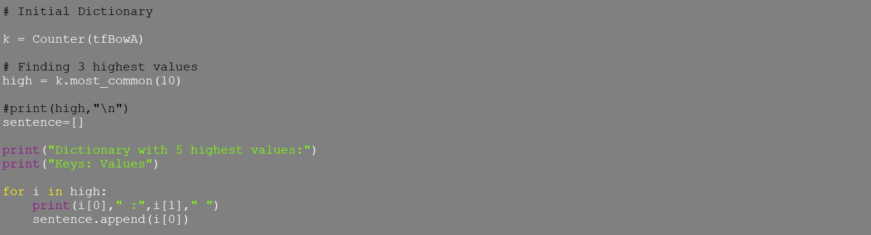
Preprocessing - Code

Slide 11
Sentence Similarity
Evaluating similarity using Cosine similarity method.
Less complicated than LSTM but not highly reliable.
Measure of similarity between 2 non zero vectors of an inner product space that measures the cosine of the angle between them.
Similarity found as a dot product of their vector representation Here the two non-zero vectors are vectors of the message and the article.
A given line in the article is extracted using a bag-of-words method.

Slide 12
Sentence Similarity
We use the following modules:
sklearn
numpy
And the following functions to perform sentence similarity:
np.array()
sklearn.metrics.pairwise.cosine_similarity()
sklearn.feature_extraction.text.CountVectorizer()
And additionally, we define two functions:
get_cosine_sim() : accepts the BoW vectors of two strings, returns the cosine similarity metric between them.
get_vectors() : accepts two strings, returns their vectors represented as in a Bag-of-Words model.

Slide 13
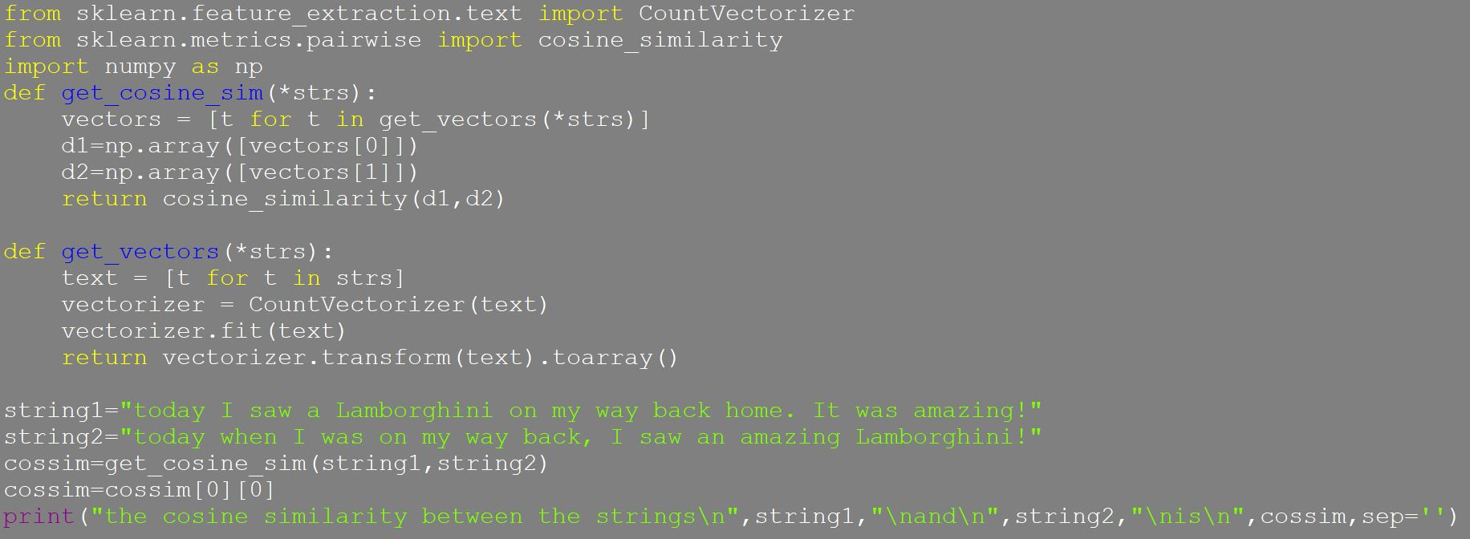
Sentence Similarity - Code

Slide 14
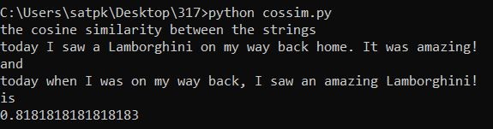
Sentence Similarity - Output

Slide 15
Sentiment Analysis
The module we used is:
Textblob
The functions we used are:
Re.sub()
textblob
We additionally defined the following functions:
Clean_text()
Get_texts()
Get_text_sentiments()

Slide 16
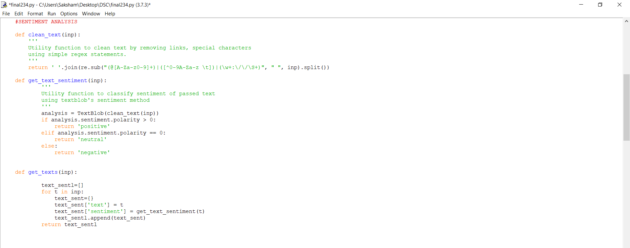
Sentiment Analysis - Code

Slide 17
Progress so far…
We can safely say that we are done with most of our project. So far, we have finished the complete scraping process, NLP pre-processing & cosine similarity assignment.
We also wish to replace the cosine similarity model with a more reliable method of sentence similarity (we are currently thinking of implementing an LSTM model).
And lastly, we wish to develop a front-end program to demonstrate how this can be implemented on the end-user’s device.

Slide 18
THANK YOU

